Slide 1



MARVEL SUPERHEROES
Presentation by 梁廣廷
資料視覺化 | 2023 FALL
Tamkang University

Slide 2
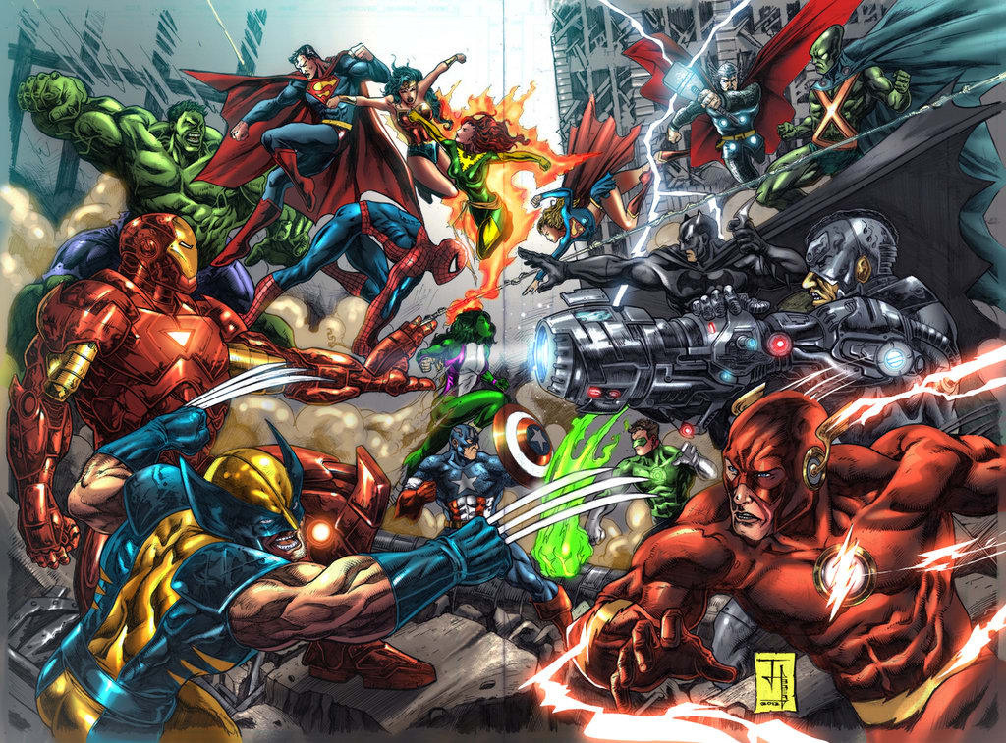
INTRODUCTION
Presentation by 梁廣廷 | 資料視覺化 | 2023 FALL | Tamkang University

Slide 3
LIBRARY
streamlit
pandas
matplotlib
seaborn
plotly
Presentation by 梁廣廷 | 資料視覺化 | 2023 FALL | Tamkang University

Slide 4
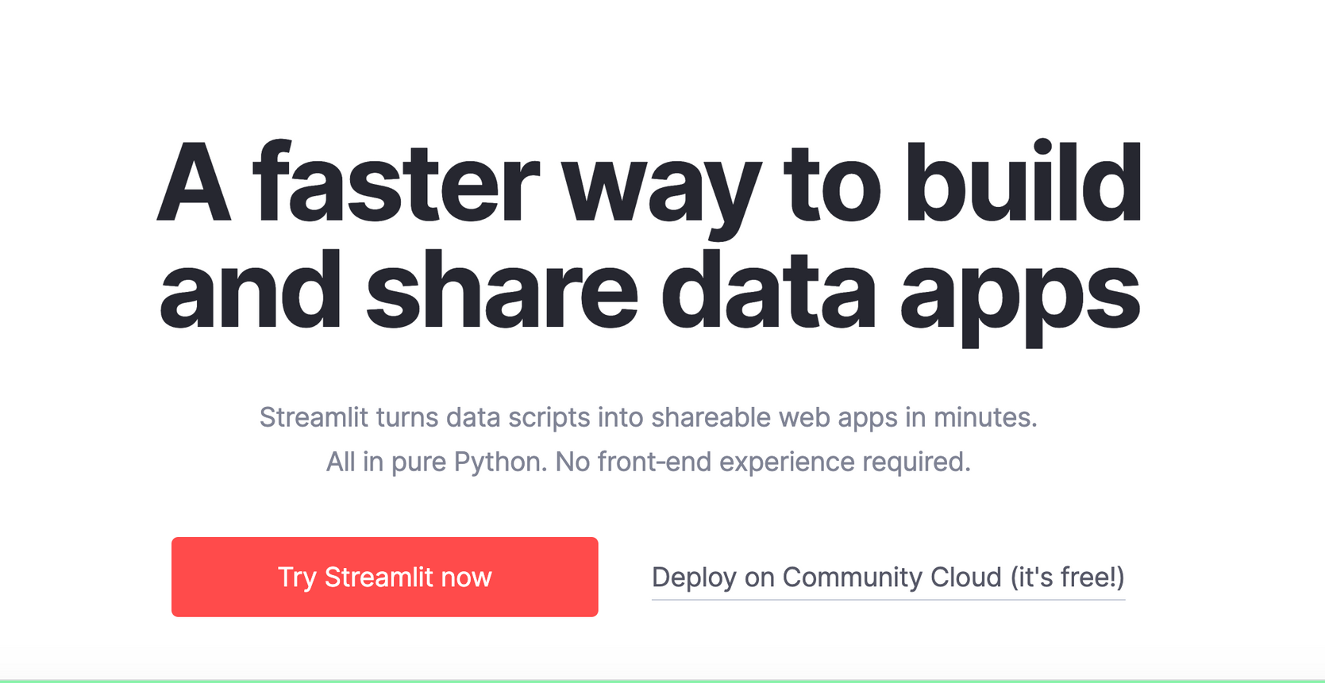
STREAMLIT
Presentation by 梁廣廷 | 資料視覺化 | 2023 FALL | Tamkang University

Slide 5

Presentation by 梁廣廷 | 資料視覺化 | 2023 FALL | Tamkang University

Slide 6

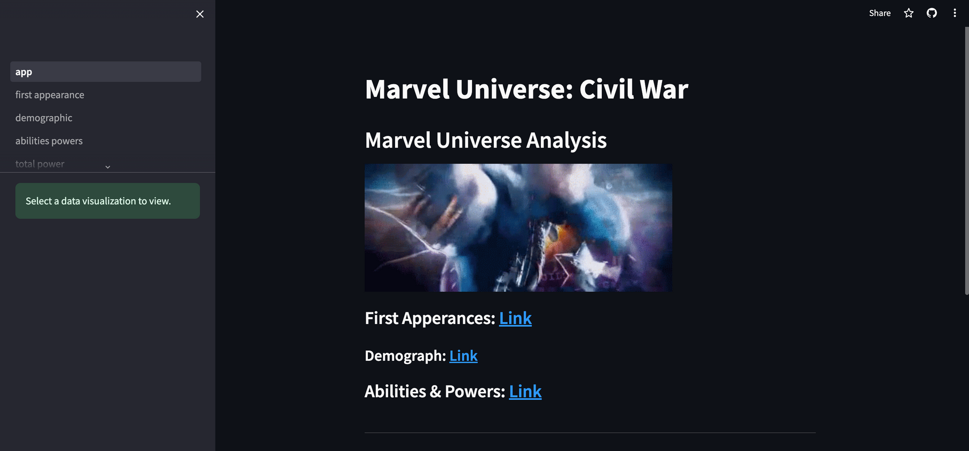

DEMO
LINK
Presentation by 梁廣廷 | 資料視覺化 | 2023 FALL | Tamkang University

Slide 7

REFERENCES
STREAMLIT FOR DATA SCIENCE:
CREATE INTERACTIVE DATA APPS IN PYTHON
DOCS.STREAMLIT.IO/
HARNESSING GITHUB COPILOT WITH PYTHON
Presentation by 梁廣廷 | 資料視覺化 | 2023 FALL | Tamkang University

Slide 8
THANK YOU
Presentation by 梁廣廷
資料視覺化 | 2023 FALL
Tamkang University

Slide 9
OUTLINE
SHOW THE DATASET NAME AND SOURCE
COLUMN NAMES DESCRIPTIONS AND RECORDS
YOUR QUESTIONS AND CORRESPONDING ANALYSIS PLOTS
CONCLUSIONS
Presentation by 梁廣廷 | 資料視覺化 | 2023 FALL | Tamkang University

Slide 10
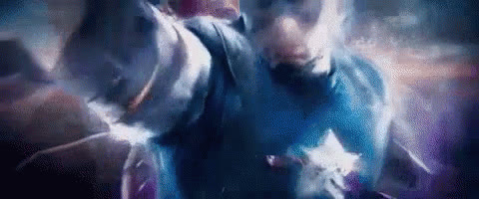
DATASET NAME
AND SOURCE ADDRESS
https://www.kaggle.com/datasets/dannielr/marvel-superheroes
Marvel Superheroes
Presentation by 梁廣廷 | 資料視覺化 | 2023 FALL | Tamkang University

Slide 11
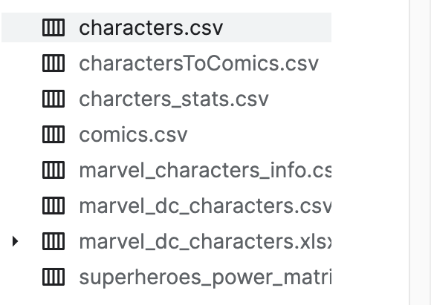
COLUMN NAMES DESCRIPTIONS AND RECORDS
Presentation by 梁廣廷 | 資料視覺化 | 2023 FALL | Tamkang University

Slide 12
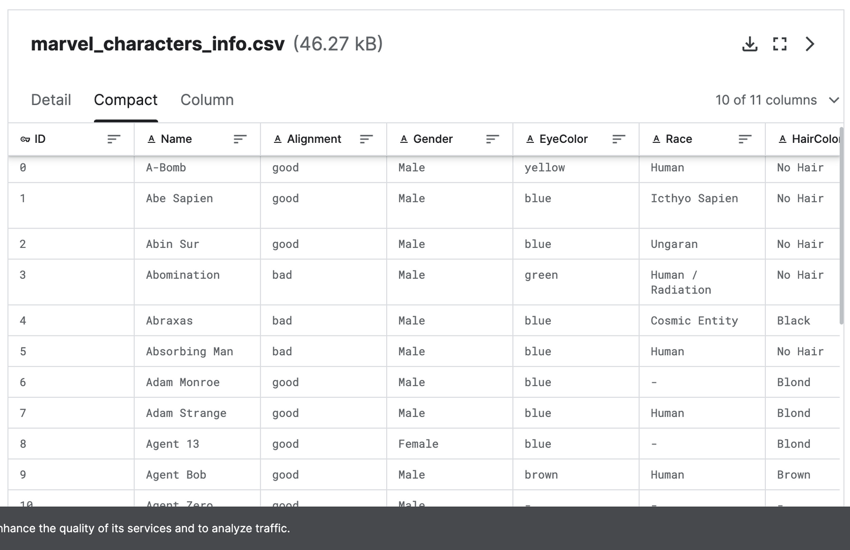
COLUMN NAMES DESCRIPTIONS AND RECORDS
Presentation by 梁廣廷 | 資料視覺化 | 2023 FALL | Tamkang University

Slide 13
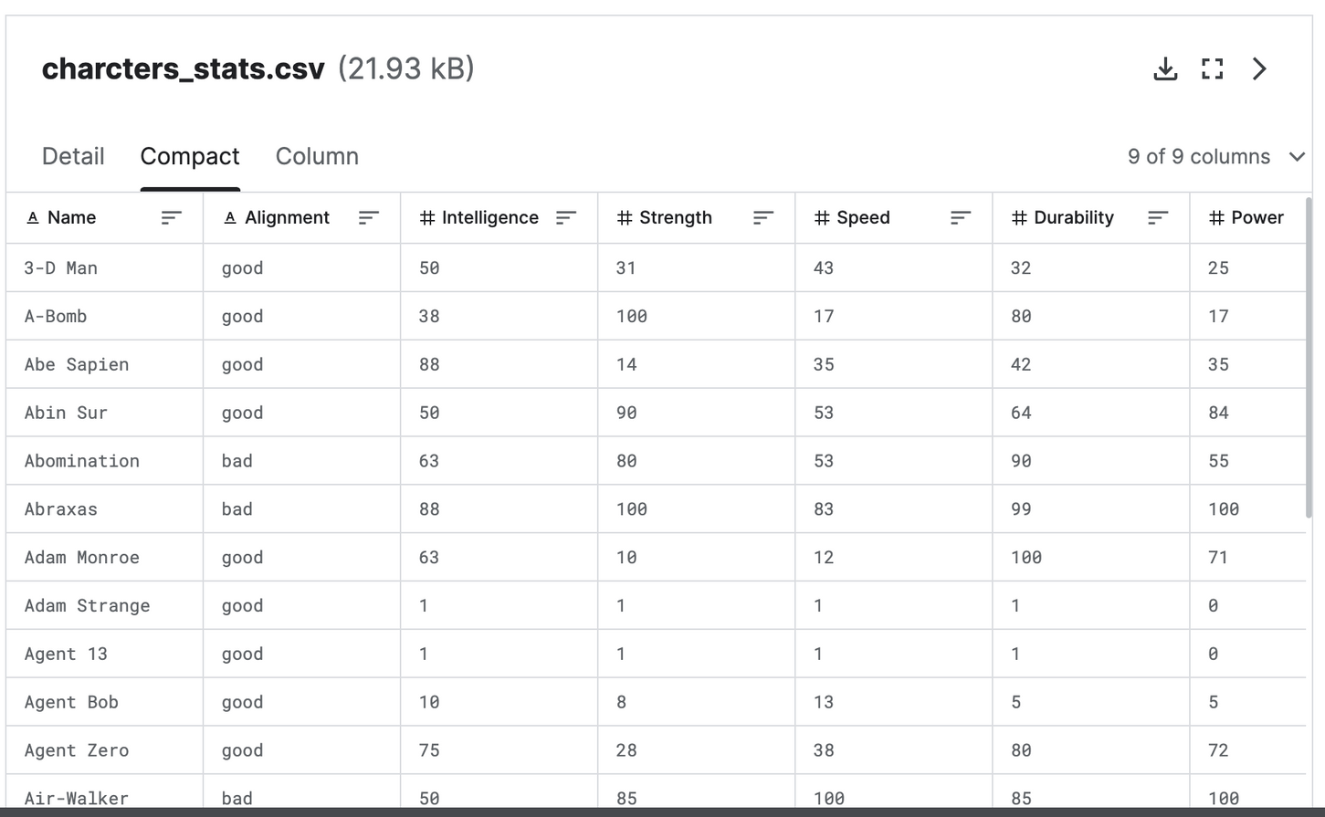
COLUMN NAMES DESCRIPTIONS AND RECORDS
Presentation by 梁廣廷 | 資料視覺化 | 2023 FALL | Tamkang University

Slide 14
QUESTIONS
YEAR OF APPEARANCE
ABILITIES & POWERS
ALIGNMENT
THE POWERGRID COMPARISON
TOTAL POWER OF THE TEAM BY CHARACTERS
GENDER VS. ALIGNMENT
COMPARISON OF CHARACTERS
IDENTITY VS. ALIGNMENT
SCATTER OF APPEARANCE AND GENDER
Presentation by 梁廣廷 | 資料視覺化 | 2023 FALL | Tamkang University

Slide 15
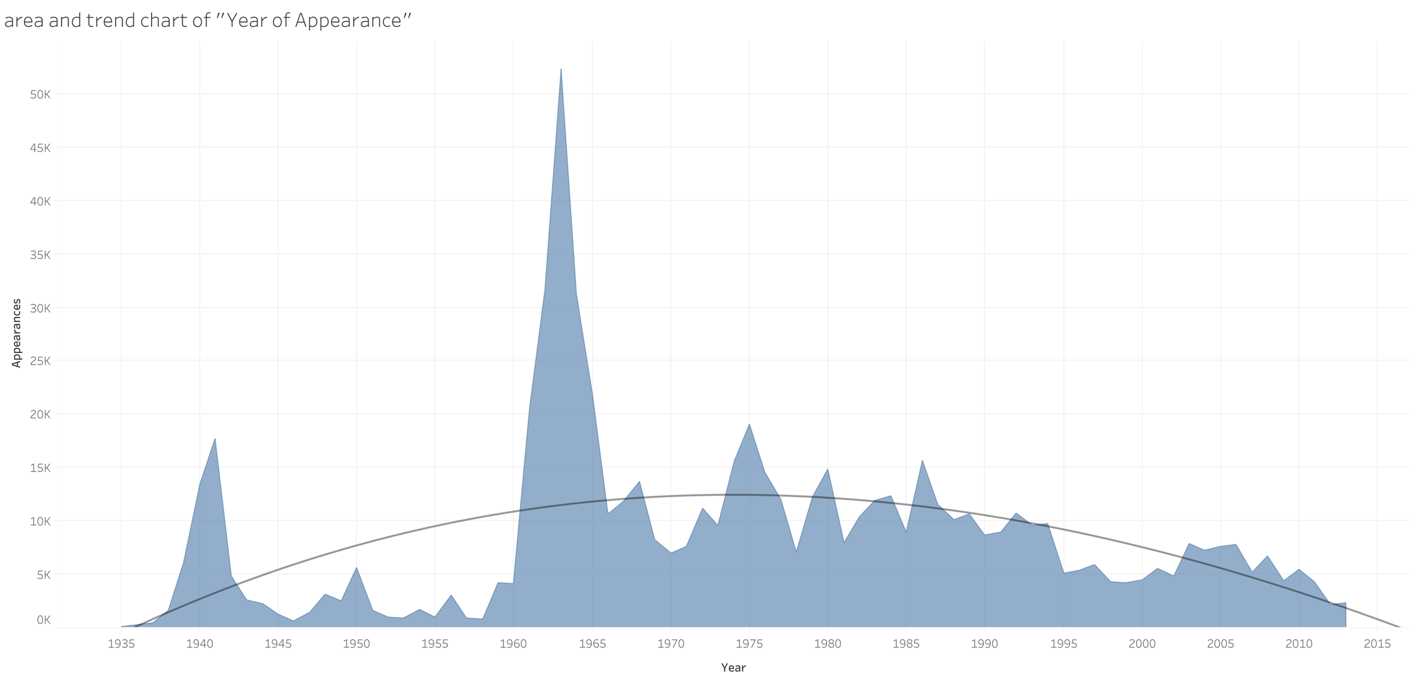
YOUR QUESTIONS AND CORRESPONDING ANALYSIS PLOTS
Presentation by 梁廣廷 | 資料視覺化 | 2023 FALL | Tamkang University

Slide 16
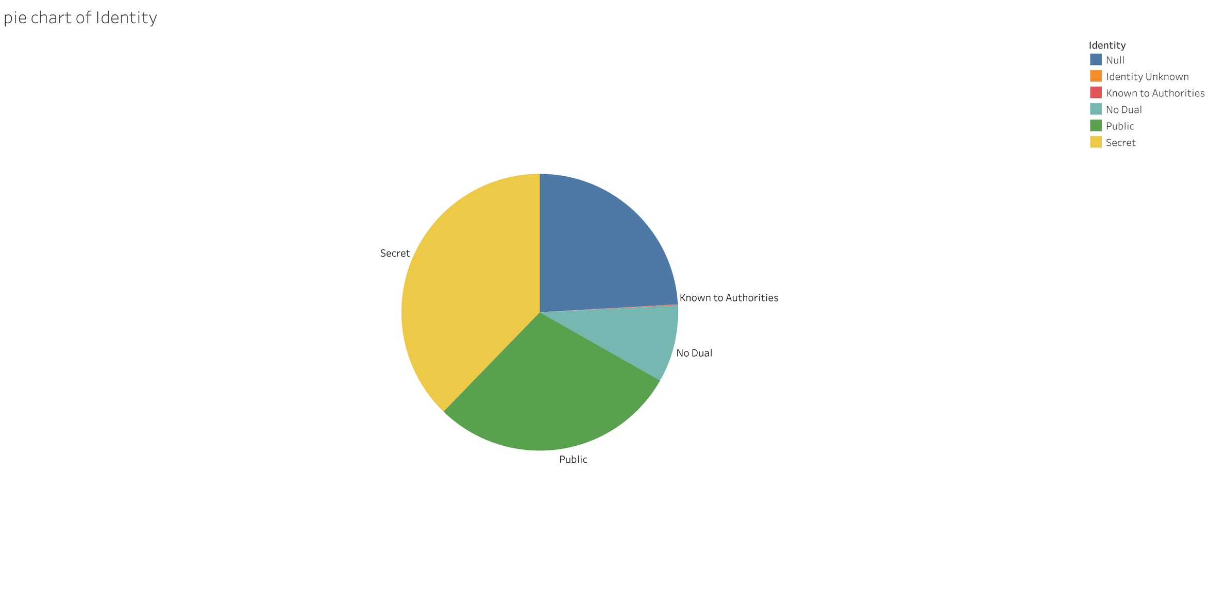
YOUR QUESTIONS AND CORRESPONDING ANALYSIS PLOTS
Presentation by 梁廣廷 | 資料視覺化 | 2023 FALL | Tamkang University

Slide 17
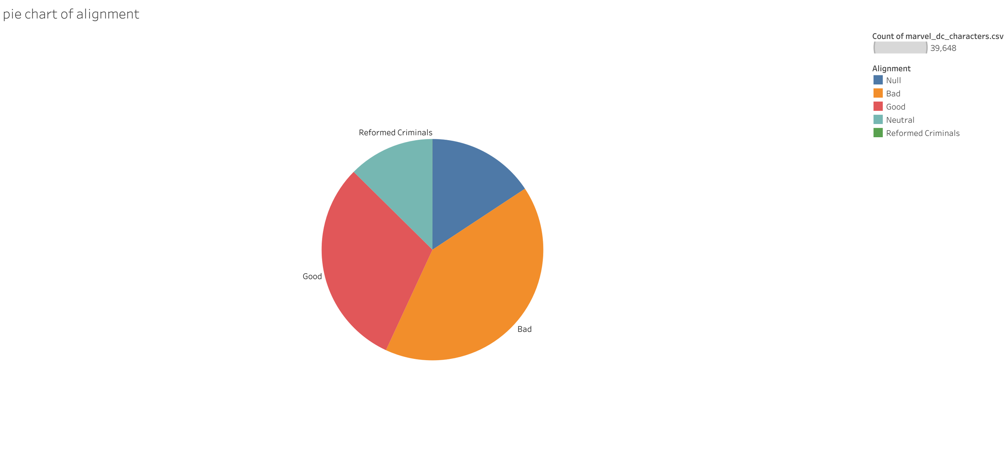
YOUR QUESTIONS AND CORRESPONDING ANALYSIS PLOTS
Presentation by 梁廣廷 | 資料視覺化 | 2023 FALL | Tamkang University

Slide 18
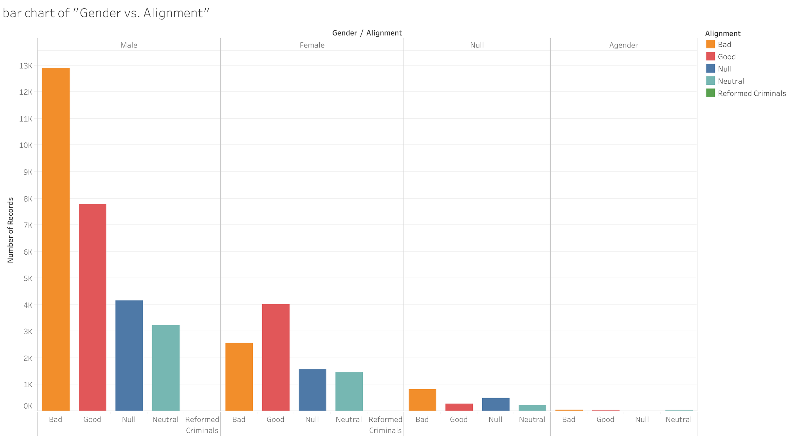
YOUR QUESTIONS AND CORRESPONDING ANALYSIS PLOTS
Presentation by 梁廣廷 | 資料視覺化 | 2023 FALL | Tamkang University

Slide 19
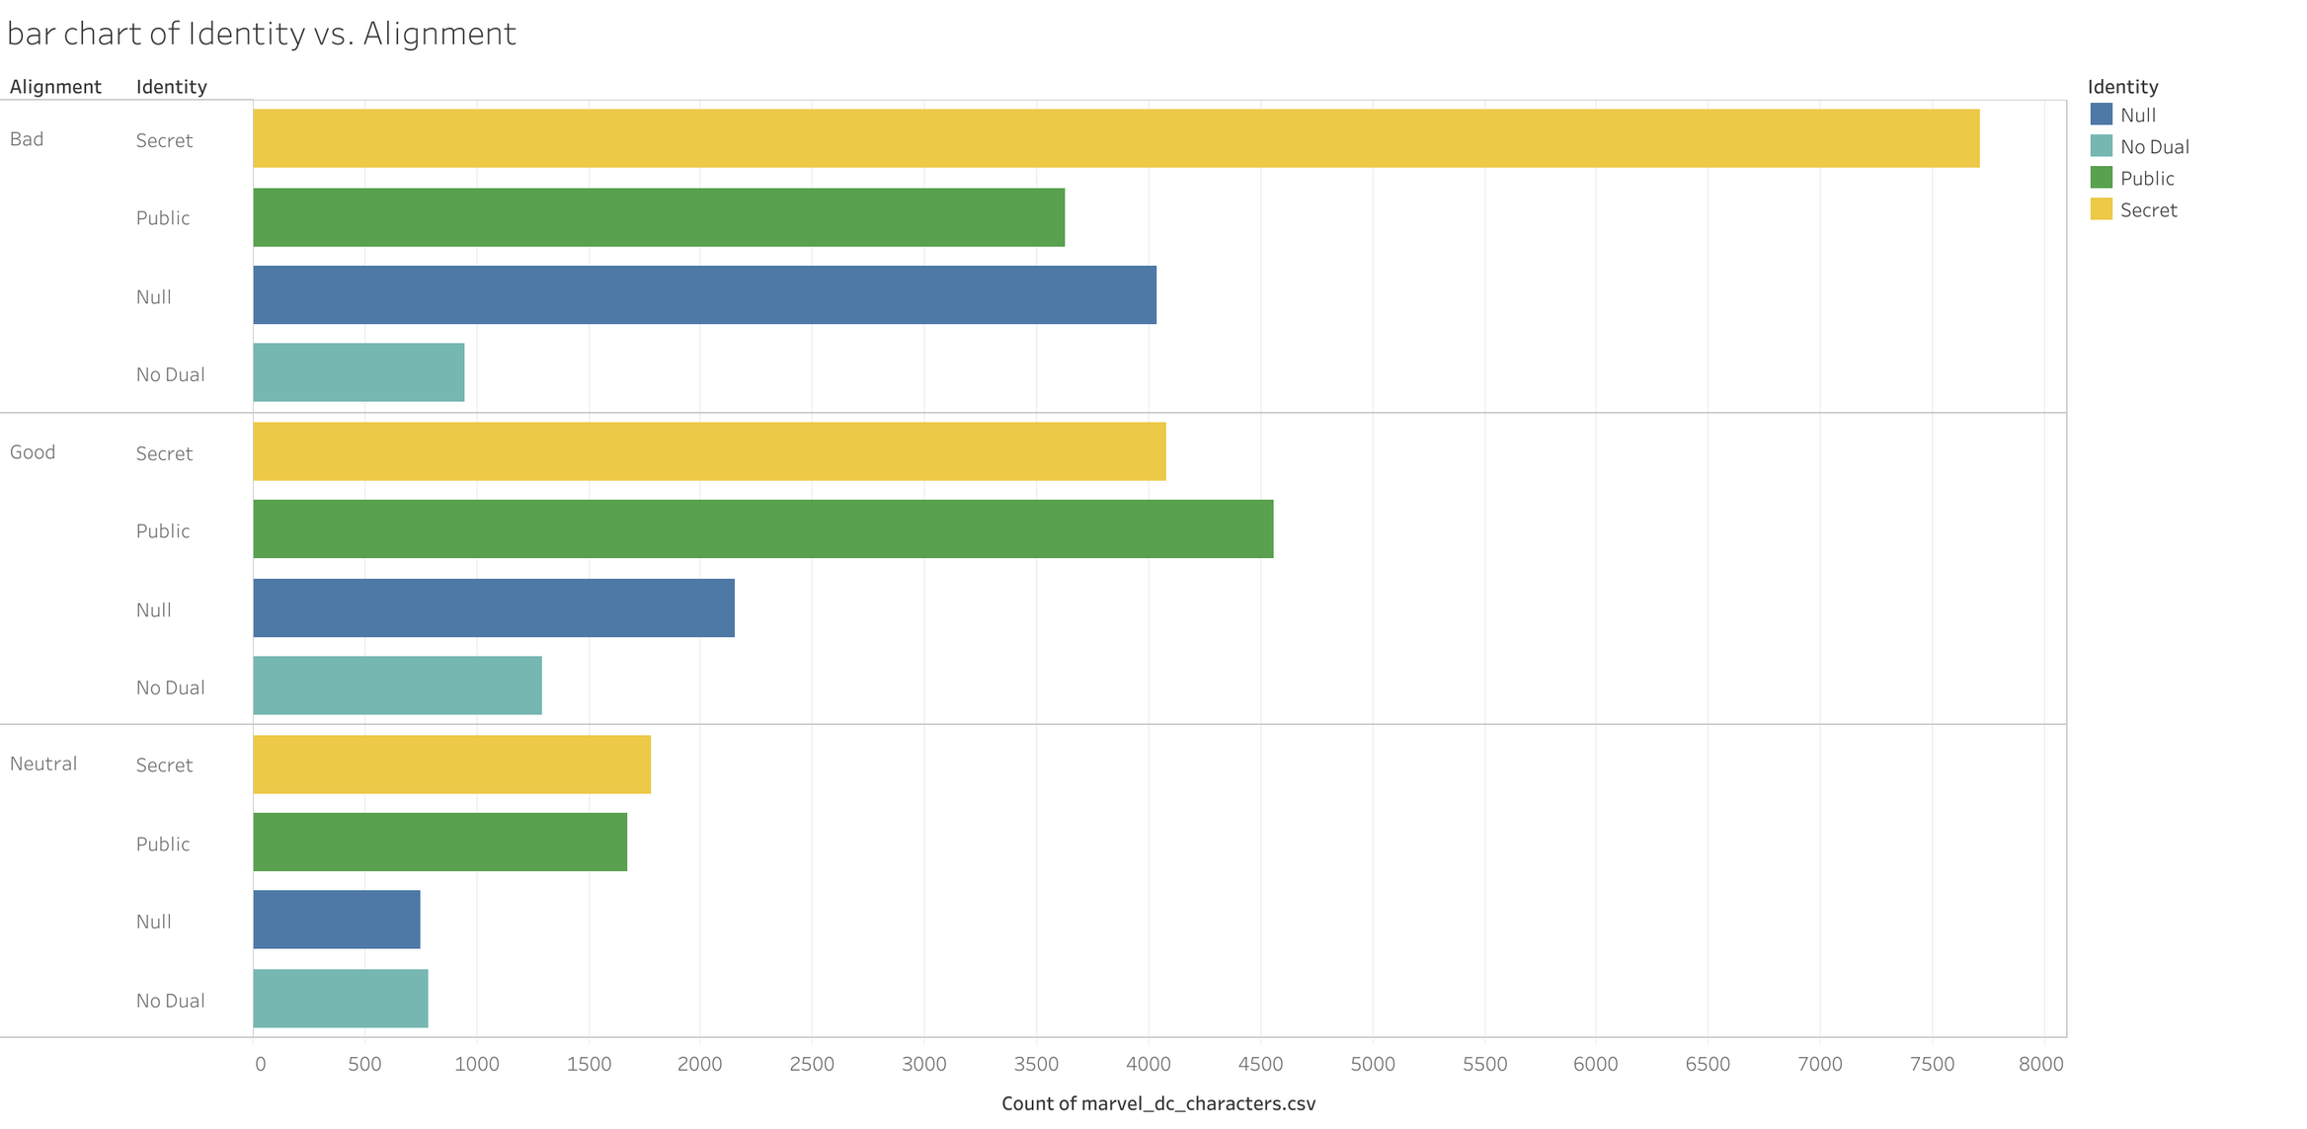
YOUR QUESTIONS AND CORRESPONDING ANALYSIS PLOTS
Presentation by 梁廣廷 | 資料視覺化 | 2023 FALL | Tamkang University

Slide 20
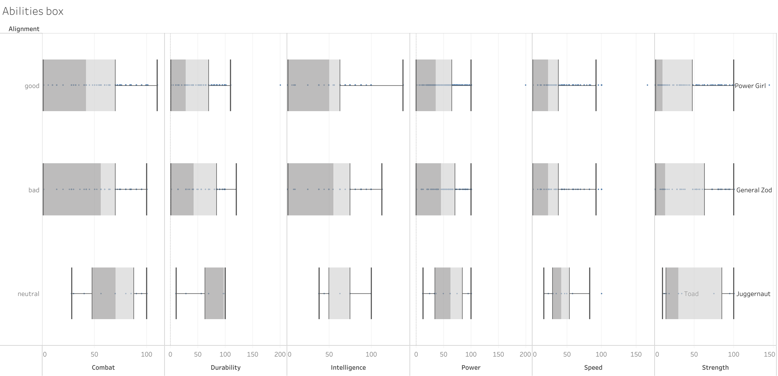
YOUR QUESTIONS AND CORRESPONDING ANALYSIS PLOTS
Presentation by 梁廣廷 | 資料視覺化 | 2023 FALL | Tamkang University

Slide 21
YOUR QUESTIONS AND CORRESPONDING ANALYSIS PLOTS
Winners of Combat
Presentation by 梁廣廷 | 資料視覺化 | 2023 FALL | Tamkang University

Slide 22
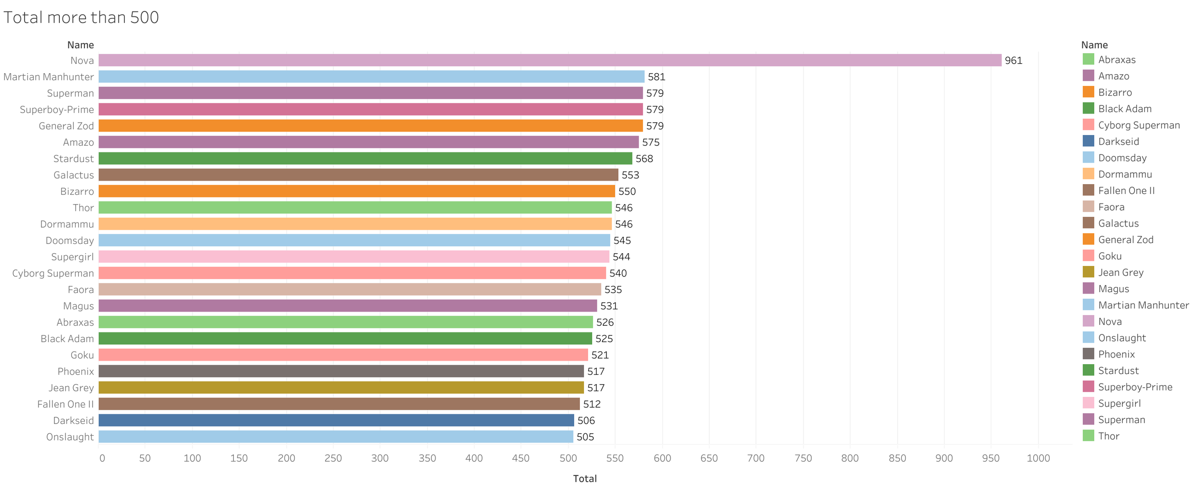
YOUR QUESTIONS AND CORRESPONDING ANALYSIS PLOTS
Presentation by 梁廣廷 | 資料視覺化 | 2023 FALL | Tamkang University

Slide 23
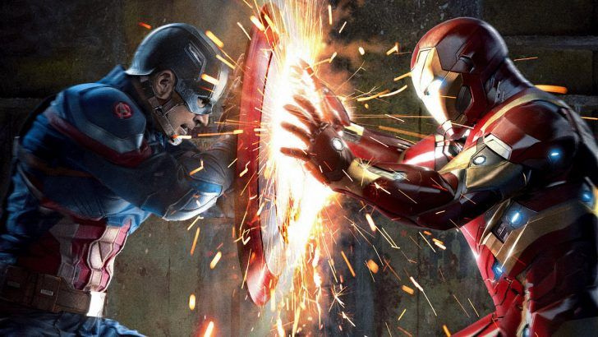
CIVIL WAR ANALYSIS
Team Cap vs Team Iron Man
Presentation by 梁廣廷 | 資料視覺化 | 2023 FALL | Tamkang University

Slide 24
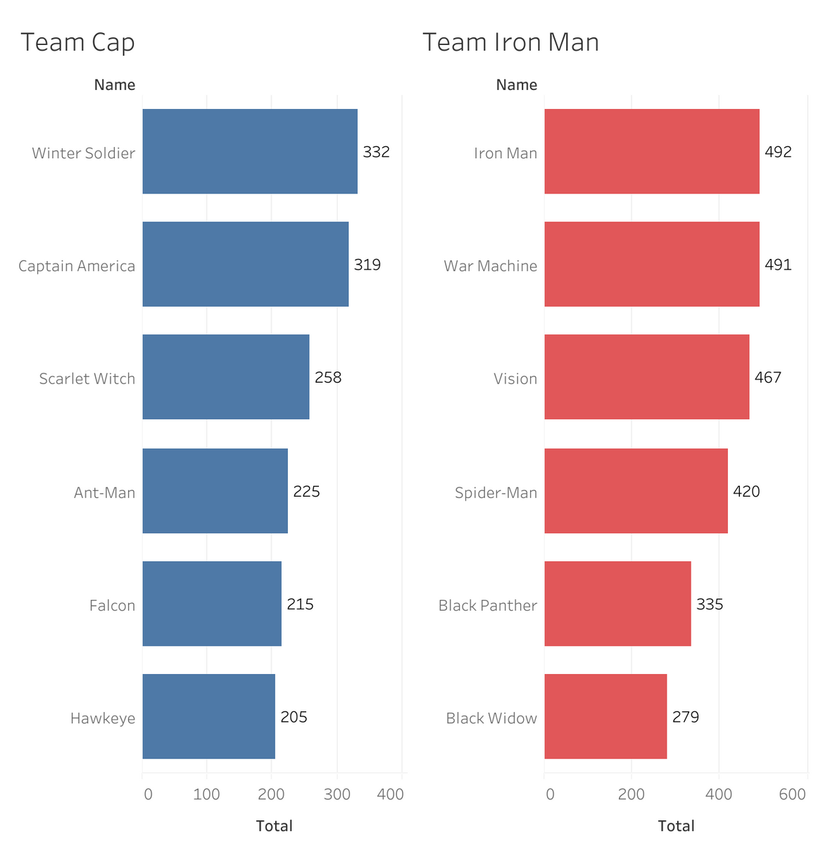
YOUR QUESTIONS AND CORRESPONDING ANALYSIS PLOTS

Slide 25
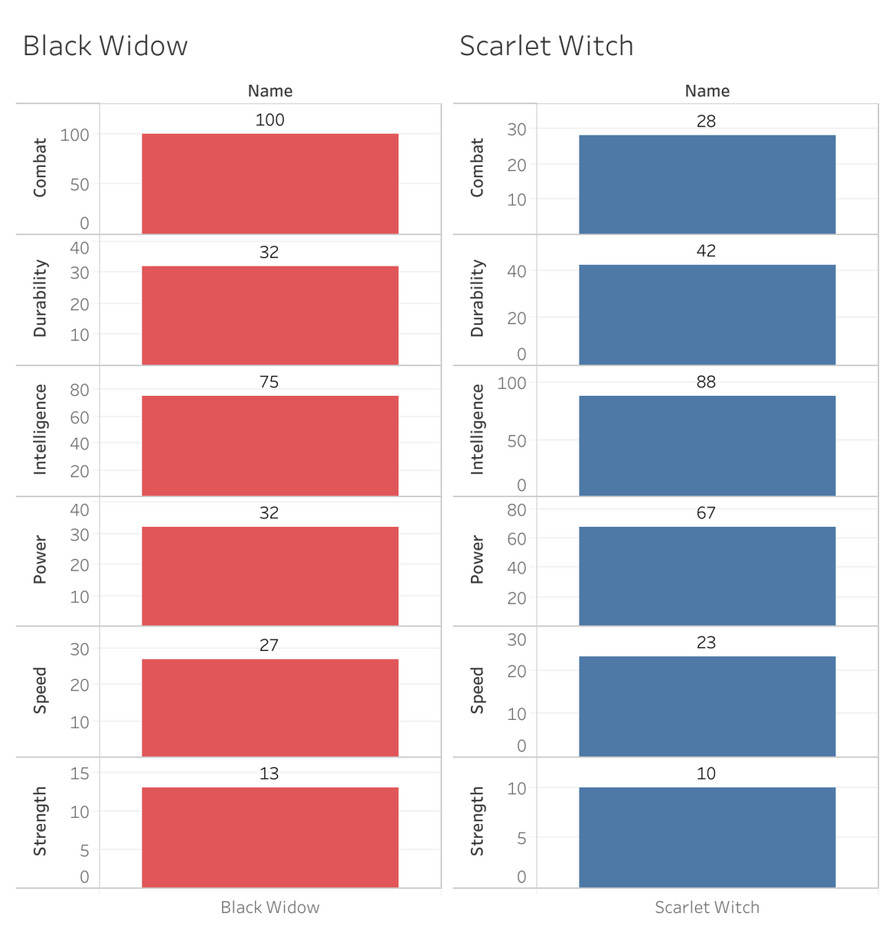
YOUR QUESTIONS AND CORRESPONDING ANALYSIS PLOTS

Slide 26
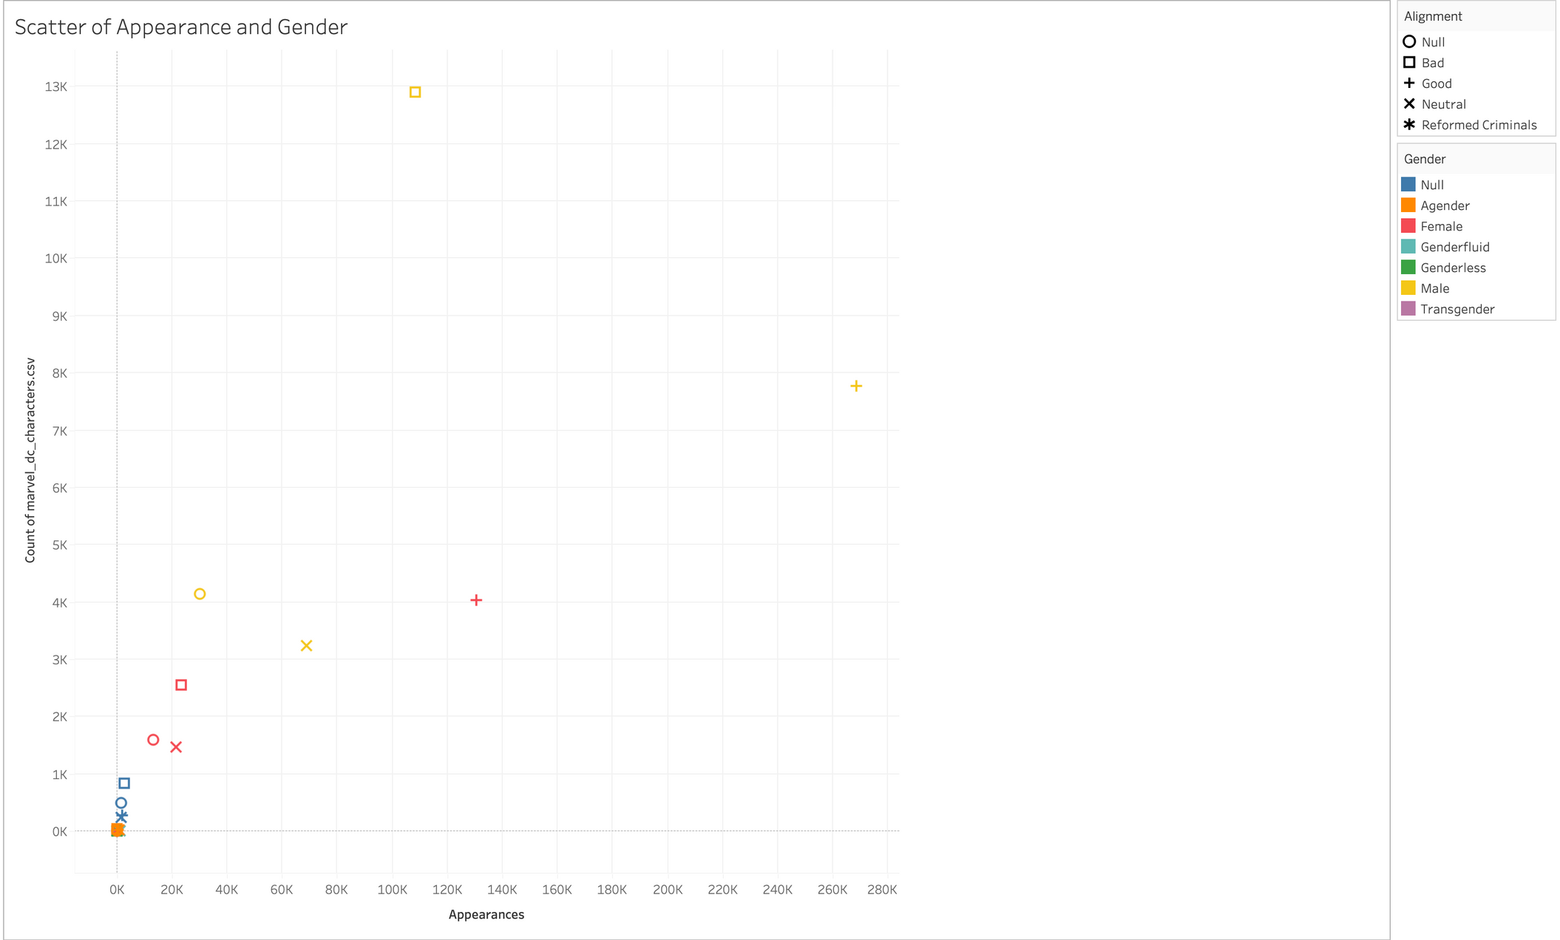
Presentation by 梁廣廷 | 資料視覺化 | 2023 FALL | Tamkang University

Slide 27
CONCLUSION
1963 Appearance the most
Secret the most
Bad the most
Nova is the most powerful hero
In civil war, Team Iron Man is more powerful
Presentation by 梁廣廷 | 資料視覺化 | 2023 FALL | Tamkang University

Slide 28
TABLEAU PUBLIC LINK
link
Presentation by 梁廣廷 | 資料視覺化 | 2023 FALL | Tamkang University

Slide 29
THANK YOU
Presentation by 梁廣廷
資料視覺化 | 2023 FALL
Tamkang University

